Slide 1

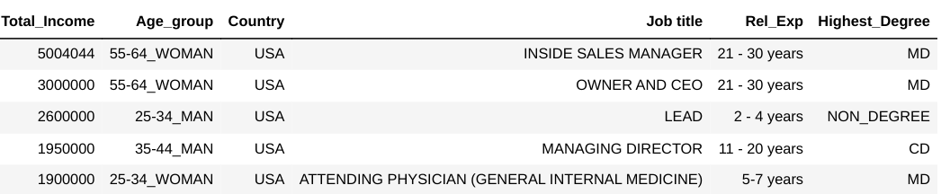
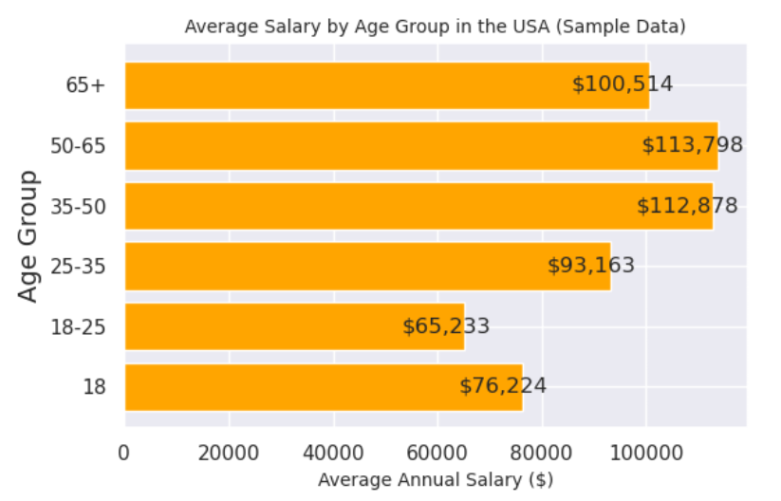
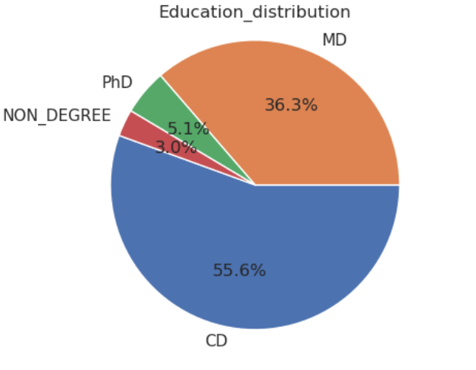
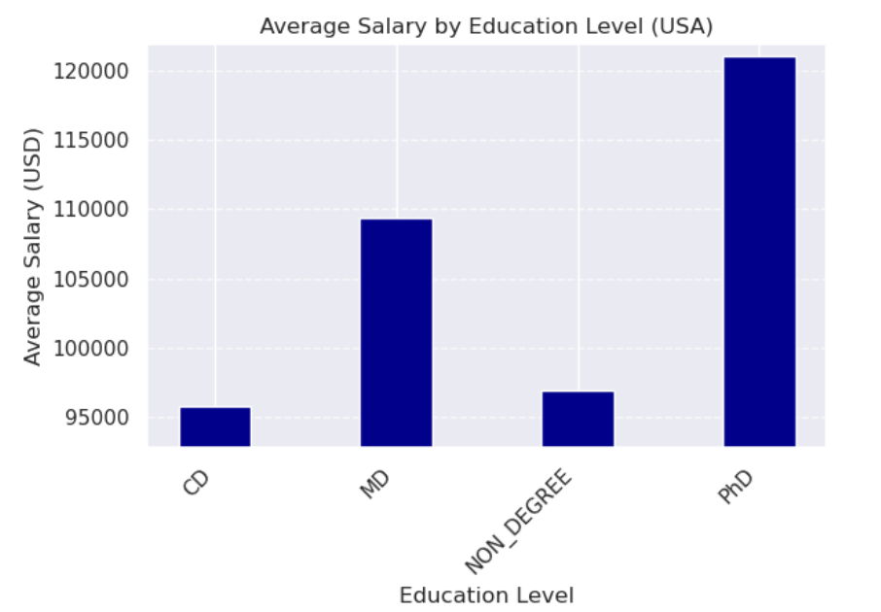
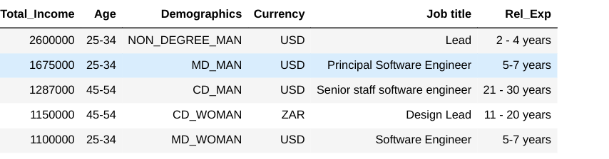
Roles
Heading size 66pt Arial bold and exactly 76pt space
second line
Researchers’ names 40pt Arial bold and exactly 50pt space between lines
¹ Department name 24pt Arial and exactly 34pt space between lines
Numerical data cleaning :missing salary values were handled by creating a new Total Income column, combining Annual Salary and Bonus. Outliers were detected, and unrealistic values (e.g., an extremely high salary) were dropped/normalised , using df.loc[3index 'Currency'] = 'value' method .Non-numeric characters in Bonus were removed and converted to integers, filling missing values with zeros. Rows with "Other" in the Currency column were filtered out, and duplicates were removed. The final dataset combined Annual Salary and Bonus into Total Income, ensuring better data integrity for analysis.
Introduction
Conclusions
The Annual Salary Survey analyzes compensation trends across industries, age groups, and countries, based on responses from 26,950 professionals with higher education degrees. Of the respondents, 76.27% identified as female, 19.42% as male, and 2.66% as non-binary. Educationally, 55.56% hold a College degree (CD), 36.35% a Master’s degree (MD), and 5.10% a PhD. Notably, 76.86% of those with higher degrees are women, highlighting key demographic trends.Salary data reveals that the highest earners occupy senior software roles. For example, a Lead earns $2.6 million USD, a Principal Software Engineer with an MD earns $1.675 million USD, These trends demonstrate the influence of education, experience, and job role on compensation, particularly in the tech sector.( Fig.1)
Text size 36pt Arial and exactly 50pt space between lines
Annual average Salary for USA : 84369.82 USD
Most highly educated gender group: Women 20704
Top performance annual salary in USA :Master degree , Non Binary ,from Alaska - 10000000 USD
Most represented job: Software Engineer,
Most represented industry: Computing or Tech
Mean Annual Salary for USA ,(USD): 77512.22
Median Annual Salary for USA, (USD): 72000.00
Results
For the salary dataset, with Annual Salary as the target variable, Iwas created a new Total Income column by combining cleaned salary and bonus data. This preserved key values that would have been lost if rows were dropped. The data cleaning process involved severplaceholdersal steps to ensure consistency and accuracy. Columns were temporarily renamed using numeric for easier manipulation and then renamed with meaningful titles (e.g., Timestamp, Age, Industry, Annual Salary). Irrelevant columns and 93 duplicate rows with missing data were removed. Missing values in key columns (e.g., Industry, Job title, State) were filled with values from related columns or defaults like 'Unknown'. Salary data was cleaned, commas removed, and outliers identified by sorting the dataset based on salary.. Gender categories are cleaned by replacing non-gender values with 'No_Gender' and standardizing to uppercase. Education data is standardized by filling missing values and renaming categories. New variables like Demographics (combining gender and education) and Age_group are created for deeper analysis.The 'Country' column was standardized by replacing variations, fixing typos, and addressing misleading entries. Regular expressions removed unwanted characters (e.g., periods, parentheses) and replaced phrases like "USA of America" with "USA." Non-country entries, such as salary-related text, were marked as "Unknown." The data was then converted to uppercase and trimmed for consistency,
Fig. 1 High-Paying Tech Roles: A CloseFig. 1 High-Paying Tech Roles: A Closer Look
r Look
References
Reference text size 15pt Arial and exactly 22pt space between lines
Our Dedication.Your Journey.
www.cct.ie
Notes:
‹#›

